Slide 1



Using Analytics to Predict Title Defects & Risks
Presented by
TEAM EVERGREENS

Slide 2







Team Evergreens
Wendy Zhang
Team Leader
Qian Zhao
Business Analyst
Xinying Xu
Data Scientist
Kaiwen Luo
Data Analyst
Tianyu Wong
Business Manager
Kewen Gu
Technical Manager
Junwei Xu
Machine Learning Engineer

Slide 3






Part 1 Background & Project Overview
Part 2 Research Question & Hypothesis
Part 3 Methodologies
Part 4 Feature Selection
Part 5 Results & Recommendations
Part 6 Value to Spruce
Part 7 Shiny Apps
TABLE
OF
CONTENTS

Slide 4

Part 1
Background & Project Overview

Slide 5

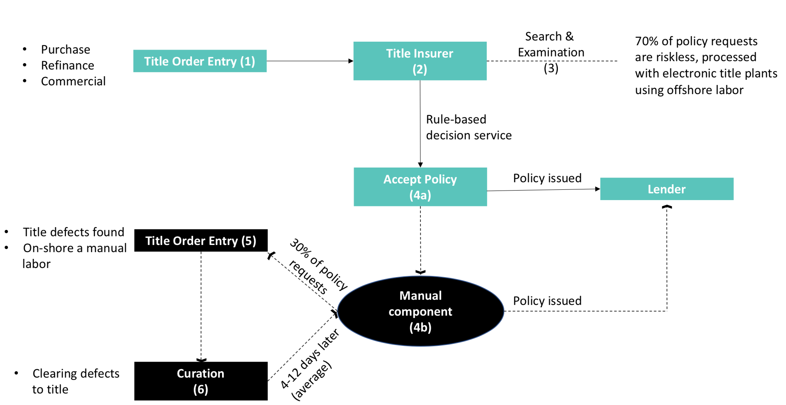
Real Estate Title Insurance Is Opaque, Complex, Confusing
Usually required by secondary mortgage market for home buyer
Protect against financial losses from lawsuits & title defects
Notes:
Setting threshold for probability
It’s not mandated by law
Most lenders buy insurance but are paid for borrowers because of the secondary owners
Government backing for title insurance
A lot of companies are trying to make the transaction easier
How can we implement those models in our business
What are the characteristics that make it very risky

Slide 6

Spruce
Spruce’s mission is to
make buying and selling real estate
simple, affordable, effortless
through proprietary digital closing technology
Notes:
1:30

Slide 7
Business Challenges
What Evergreens Does
Objective
More Accurate Prediction for Title Risk
More informed underwriting decisions
Analyze data of property owners and title defects
Determine most predictive attributes for title risk
Title search alone is not sufficient to evaluate title risks: also need to predict a property’s likelihood of involving a lawsuit
Notes:
Title insurance is a niche but sizable market, the files and records of title are all public, so Spruce faces challenges from new entrants and threats of cutting-edge technologies, such as blockchains. In this project, we will first analyze data, determine the useful attributes and build a high-accuracy model to predict the risks. So that we could help Spruce could predict the risks accurately and stay competitive in its field.

Slide 8
Part 2
Research Question & Hypothesis

Slide 9

Research Q1
Do historical data sufficiently predict title defects?
Research Q2
Which features are most predictive of title defects?
Null Hypothesis
The given historical data cannot accurately predict title defects.
Notes:
Based on that, we raised two research questions: first, is historical data that we have sufficient to predict the title defects? and if so, which features are most predictive of title defects? And the null hypothesis, in this case, is that the given historical data cannot accurately predict the title defects.
3:00

Slide 10
Part 3
Methodologies

Slide 11
Methodologies Overview
Data exploration
Data pre-processing
Models
Feature selection
Data resampling
Notes:
但是我们不是先用feature 再用model test吗

Slide 12
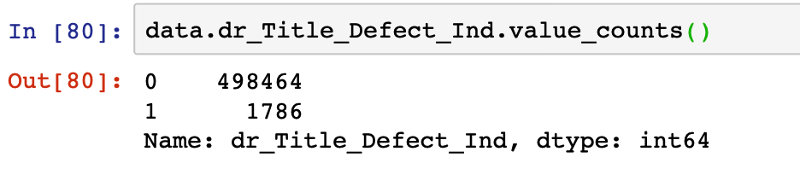
Data Exploration
Data Exploration
Data collected from 3 counties
500,250 observations
54 variables
Target: dr_Title_Defect_Ind
Imbalanced dataset -> less than 0.35% of data has title defects
Data Pre-processing
Data Resampling
Model Selection
Evaluation Criteria

Slide 13
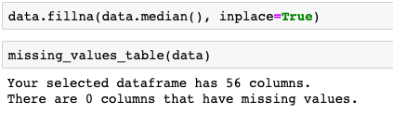
Fill Missing Value
Data Exploration
Data Pre-processing
2. Handle Outliers
Identify outliers in data using median & quartile range
Locate the outliers in each variable using boxplot
Trim out data entries with outliers
Data Resampling
Model Selection
Evaluation Criteria
3. Split Data
Split the data into the training dataset and testing dataset
Goal: avoid overfitting or underfitting issues

Slide 14
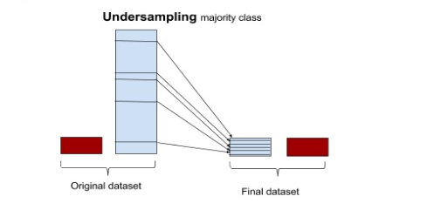
Resampling techniques
a. Undersampling with NearMiss
One of the most common and simplest strategies to handle imbalanced data is to undersample the majority class. For this analysis, we simply selected n samples at random from the majority class, where n is the number of samples for the minority class, and use them during training phase, after excluding the sample to use for validation.
Data Exploration
Data Pre-processing
Data Resampling
Model Selection
Evaluation Criteria

Slide 15
Resampling techniques
b. Oversampling with SMOTE
This method works with minority class to replicate the observations from minority class to balance the data. Similar to undersampling, this method also can be divided into two types: Random Oversampling and Informative Oversampling. An advantage of using this method is that it leads to no information loss. The disadvantage of using this method is that, it ends up adding multiple observations of several types, thus leading to overfitting.
Data Exploration
Data Pre-processing
Data Resampling
Model Selection
Evaluation Criteria

Slide 16
Model Selection
Linear Regression
Linear regression model is an analysis that uses the least square function to model the relationship between independent and dependent variables. With simple logic, the linear regression model is easy to implement, and the results also have good interpretability. Although linear regression is relatively easy to understand, it contains many important ideas in machine learning.
Logistics Regression
Logistic regression is the appropriate regression analysis to conduct when the dependent variable is dichotomous (binary).
Data Exploration
Data Pre-processing
Data Resampling
Model Selection
Evaluation Criteria

Slide 17
Model Selection
c. Random Forest
Random forest is an ensemble learning method for classification, regression and other tasks that operates by constructing a multitude of decision trees at training time and outputting the class that is the mode of the classes (classification) or mean prediction (regression) of the individual trees.
d. XGBoost
Gradient boosting is a powerful machine learning technique for regression and classification problems, which produces a prediction model in the form of an ensemble of weak prediction models, typically decision trees.
e. Support Vector Machine
SVM is a supervised learning algorithm used to solve binary classification problems. SVM can also be used to solve nonlinear problems with the introduction of kernel methods.
Data Exploration
Data Pre-processing
Data Resampling
Model Selection
Evaluation Criteria

Slide 18

Evaluation Criteria
True Positives: correctly classified title defect
False Positives: incorrectly classified title defect
True Negative: correctly classified non-title defect
False Negative: incorrectly classified non-title defect
Accuracy: correctly classified obs / total # of obs
Precision: True Positives / (True Positives + False Positives)
Recall: True Positives / (True Positives + False Negatives)
F-1: 2 * (Precision * Recall) / (Precision + Recall)
Can be interpreted as a weighted average of the precision and recall, or a balance between the two.
Data Exploration
Data Pre-processing
Data Resampling
Model Selection
Evaluation Criteria

Slide 19
Part 4
Feature Selection

Slide 20
Univariate Selection
Univariate Selection
Feature Importance Selection
Based on univariate statistical tests
Scikit-learn library
8 variables
Forward Stepwise
Backward Stepwise
Hybrid Stepwise
Ridge Regression
 | Recall Score | Precision Score | F1 Score
Logistic | 0.72591 | 0.003167 | 0.006308
Random Forest | 0.925053 | 0.003479 | 0.006932
XGBoost | 0.983654 | 0.004565 | 0.006278
SVM | 0.970454 | 0.003425 | 0.006826
Lasso Regression
Elastic Net Regression
Principal Component Analysis
Linear Discriminant Analysis

Slide 21
Univariate Selection
Feature Importance Selection
Feature Importance Selection
Feature importance property of the model
Extra Tree Classifier
8 Variables
Forward Stepwise
Backward Stepwise
Hybrid Stepwise
Ridge Regression
 | Recall Score | Precision Score | F1 Score
Logistic | 0.834051 | 0.003505 | 0.006981
Random Forest | 0.982758 | 0.003660 | 0.007293
XGBoost | 0.976932 | 0.003065 | 0.007216
SVM | 0.982758 | 0.003658 | 0.007289
Lasso Regression
Elastic Net Regression
Principal Component Analysis
Linear Discriminant Analysis

Slide 22
Univariate Selection
Forward Stepwise Selection
Feature Importance Selection
Starting out with zero feature
Adds the feature with the lowest p-value to the working model
Machine learning iteration
8 Features
Forward Stepwise
Backward Stepwise
Hybrid Stepwise
 | Recall Score | Precision Score | F1 Score
Linear | 0.857788 | 0.003395 | 0.006763
Logistic | 0.952596 | 0.003583 | 0.007139
Random Forest | 0.988713 | 0.003516 | 0.007008
XGBoost | 0.986455 | 0.003512 | 0.006998
SVM | 0.735892 | 0.004682 | 0.009306
Ridge Regression
Lasso Regression
Elastic Net Regression
Principal Component Analysis
Linear Discriminant Analysis

Slide 23
Univariate Selection
Backward Stepwise Selection
Feature Importance Selection
Starting out with all features
Remove the feature with the highest p-value from the working model
Machine learning iterations
Forward Stepwise
Backward Stepwise
Hybrid Stepwise
 | Recall Score | Precision Score | F1 Score
Linear | 0.783296 | 0.003203 | 0.006380
Logistic | 0.794582 | 0.003068 | 0.006113
Random Forest | 0.932280 | 0.003329 | 0.006635
XGBoost | 0.887133 | 0.003195 | 0.006366
SVM | 0.512415 | 0.002199 | 0.004379
Ridge Regression
Lasso Regression
Elastic Net Regression
Principal Component Analysis
Linear Discriminant Analysis

Slide 24
Univariate Selection
Hybrid Stepwise Selection
Feature Importance Selection
Combination of forward and backward selection
Initial step is the same as the forward stepwise selection
Remove features previously added but now have an insignificant p-value
Forward Stepwise
Backward Stepwise
Hybrid Stepwise
Ridge Regression
 | Recall Score | Precision Score | F1 Score
Linear | 0.896163 | 0.003745 | 0.007458
Logistic | 0.963883 | 0.003477 | 0.006928
Random Forest | 0.972912 | 0.003463 | 0.006901
XGBoost | 0.970655 | 0.003458 | 0.006892
SVM | 0.878104 | 0.003463 | 0.006898
Lasso Regression
Elastic Net Regression
Principal Component Analysis
Linear Discriminant Analysis

Slide 25
Univariate Selection
Ridge Regression
Feature Importance Selection
Regularization, Y ≈ β0 + β1X1 + β2X2 + …+ βpXp
Shrink coefficients to help reduce the model complexity and multicollinearity
Penalize sum of squared coefficients (L2 penalty)
Ridge works well when most predictors impact the target
Forward Stepwise
Backward Stepwise
Hybrid Stepwise
Ridge Regression
 | Recall Score | Precision Score | F1 Score
Linear | 0.483069 | 0.007210 | 0.014209
Logistic | 0.489841 | 0.007168 | 0.014130
Random Forest | 0.702031 | 0.004281 | 0.008511
XGBoost | 0.681715 | 0.005384 | 0.010685
SVM | 0.444695 | 0.007997 | 0.015712
Lasso Regression
Elastic Net Regression
Principal Component Analysis
Linear Discriminant Analysis

Slide 26
Univariate Selection
Lasso Regression
Feature Importance Selection
Regularization, Y ≈ β0 + β1X1 + β2X2 + …+ βpXp
Shrink coefficients to help reduce the model complexity and multicollinearity
Penalize sum of absolute values (L1 penalty)
Lasso tends to do well when only a few predictors actually influence the target
Forward Stepwise
Backward Stepwise
Hybrid Stepwise
 | Recall Score | Precision Score | F1 Score
Linear | 0.686230 | 0.006299 | 0.012485
Logistic | 0.726862 | 0.005676 | 0.011264
Random Forest | 0.988713 | 0.003522 | 0.007019
XGBoost | 0.988713 | 0.003521 | 0.007018
SVM | 0.975169 | 0.003630 | 0.007233
Ridge Regression
Lasso Regression
Elastic Net Regression
Principal Component Analysis
Linear Discriminant Analysis

Slide 27
Univariate Selection
Elastic Net Regression
Feature Importance Selection
Regularization, Y ≈ β0 + β1X1 + β2X2 + …+ βpXp
Combine the penalties of ridge and lasso to get the best of both worlds
Select 9 variables with non-zero coefficients
Forward Stepwise
Backward Stepwise
Hybrid Stepwise
Ridge Regression
 | Recall Score | Precision Score | F1 Score
Linear | 0.519187 | 0.010297 | 0.020194
Logistic | 0.747178 | 0.003020 | 0.006016
Random Forest | 0.927765 | 0.003308 | 0.006592
XGBoost | 0.887133 | 0.003216 | 0.006408
SVM | 0.914221 | 0.003265 | 0.006506
Lasso Regression
Elastic Net Regression
Principal Component Analysis
Linear Discriminant Analysis

Slide 28
Univariate Selection
Principal Component Analysis
Feature Importance Selection
Reduce dimensionality of a dataset consisting of large number of interrelated variables, while retaining as much as possible of the variation in the dataset
Forward Stepwise
Backward Stepwise
Hybrid Stepwise
Ridge Regression
 | Recall Score | Precision Score | F1 Score
Linear | 0.643340 | 0.006162 | 0.012207
Logistic | 0.884875 | 0.003623 | 0.007217
Random Forest | 0.988713 | 0.003521 | 0.007017
XGBoost | 0.981941 | 0.003594 | 0.007163
SVM | 0.848758 | 0.003861 | 0.007688
Lasso Regression
Elastic Net Regression
Principal Component Analysis
Linear Discriminant Analysis

Slide 29
Univariate Selection
Linear Discriminant Analysis
Feature Importance Selection
Similar to PCA
The goal is to project a dataset onto a lower-dimensional space with good class-separability in order to avoid overfitting
Forward Stepwise
Backward Stepwise
Hybrid Stepwise
Ridge Regression
 | Recall Score | Precision Score | F1 Score
Linear | 0.810384 | 0.003257 | 0.006488
Logistic | 0.828442 | 0.003271 | 0.006517
Random Forest | 0.805869 | 0.003363 | 0.006697
XGBoost | 0.898420 | 0.003226 | 0.006430
SVM | 0.905192 | 0.003239 | 0.006454
Lasso Regression
Elastic Net Regression
Principal Component Analysis
Linear Discriminant Analysis

Slide 30
Comparison of Results
 | Best Model | Recall Score | Precision Score | F1 Score
Forward Stepwise | SVM | 0.740406 | 0.004520 | 0.008986
Backward Stepwise | Random Forest | 0.932280 | 0.003329 | 0.006635
Hybrid Stepwise | Linear | 0.643340 | 0.006162 | 0.007458
Ridge | SVM | 0.444695 | 0.007997 | 0.015712
Lasso | Linear | 0.686230 | 0.006299 | 0.012485
Elastic Net | Linear | 0.519187 | 0.010297 | 0.020194
Principal Component | Linear | 0.643340 | 0.006162 | 0.012207
Linear Discriminate | Random Forest | 0.805869 | 0.003363 | 0.006697

Slide 31
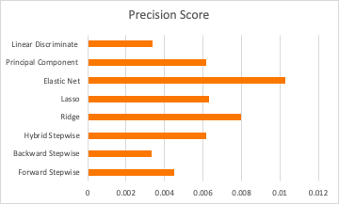
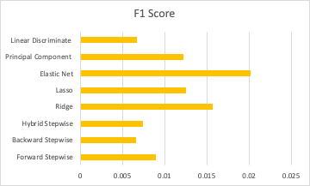
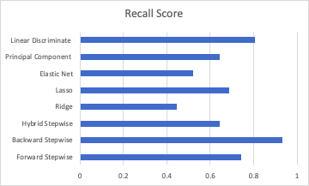
Comparison of Results
Best performer: Elastic Net Regression
Accuracy (correctly predicted): 0.821538
Recall on 1 (true title defect) : 0.519187
Recall on 0 (false/no title defect): 0.822613

Slide 32
Part 5
Results & Recommendations

Slide 33
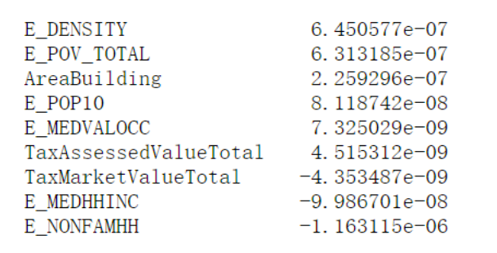
Selected Features
Elastic Net Linear regression model

Slide 34


Population Density of Zip Code
E_DENSITY
E_POV_TOTAL
E_DENSITY
The higher the population density, the more likely a real estate would have a title defect.
Possible drivers of title defects
More residents living in a single housing unit
Higher concentration of housing units/housing type
E_POP10
E_NONFAMHH
AreaBuilding
TaxAssessedValueTotal
TaxMarketValueTotal
E_MEDHHINC
E_MEDVALOCC

Slide 35
Total Population in Poverty
E_DENSITY
E_POV_TOTAL
E_POV_TOTAL
The more people there are in poverty, the more likely a real estate would have a title defect.
Possible drivers of title defects
More people cannot afford real estate closing clerks or agents
E_POP10
E_NONFAMHH
AreaBuilding
TaxAssessedValueTotal
TaxMarketValueTotal
E_MEDHHINC
E_MEDVALOCC

Slide 36
Population of 4/1/2010
E_DENSITY
E_POV_TOTAL
E_POP10
The higher the population, the more likely a real estate would have a title defect.
Possible drivers of title defects
Greater demands for real estates translates to more real estate transactions, which breed more occurrences of title defects
E_POP10
E_NONFAMHH
AreaBuilding
TaxAssessedValueTotal
TaxMarketValueTotal
E_MEDHHINC
E_MEDVALOCC

Slide 37
Non-Family Households
E_DENSITY
E_POV_TOTAL
E_NONFAMHH
Non-family households are more likely to be involved in title defects
Possible drivers of title defects
Families are more prudent and more risk-averse
E_POP10
E_NONFAMHH
AreaBuilding
TaxAssessedValueTotal
TaxMarketValueTotal
E_MEDHHINC
E_MEDVALOCC

Slide 38
Living Square Ft of All Structures on The Property
E_DENSITY
E_POV_TOTAL
AreaBuilding
The larger the living square the property has, the more likely a real estate would have a title defect.
Possible drivers of title defects
Large living areas of property brings more profits, and it involves more people and more business.
E_POP10
E_NONFAMHH
AreaBuilding
TaxAssessedValueTotal
TaxMarketValueTotal
E_MEDHHINC
E_MEDVALOCC

Slide 39
Total Assessed Value
E_DENSITY
E_POV_TOTAL
TaxAssessedValueTotal
The higher the total assessed value has, the more likely a real estate would have a title defect.
Possible drivers of title defects
The higher assessed value would attract more people to take advantage of the property
E_POP10
E_NONFAMHH
AreaBuilding
TaxAssessedValueTotal
TaxMarketValueTotal
E_MEDHHINC
E_MEDVALOCC

Slide 40
Total Market Value
E_DENSITY
E_POV_TOTAL
TaxMarketValueTotal
The lower the total market value, the more likely a real estate would have a title defect.
Possible drivers of title defects
People always want to overprice the market value so that they can sell their property.
E_POP10
E_NONFAMHH
AreaBuilding
TaxAssessedValueTotal
TaxMarketValueTotal
E_MEDHHINC
E_MEDVALOCC

Slide 41
Median Household Income
E_DENSITY
E_POV_TOTAL
E_MEDHHINC
The lower the median household income, the more likely a real estate would have a title defect.
Possible drivers of title defects
People with lower incomes don’t have enough money to pay the tax of their house
E_POP10
E_NONFAMHH
AreaBuilding
TaxAssessedValueTotal
TaxMarketValueTotal
E_MEDHHINC
E_MEDVALOCC

Slide 42
Housing, Median Value of Owner Household
E_DENSITY
E_POV_TOTAL
E_MEDVALOCC
The lower the median value of owner households, the more likely a real estate would have a title defect.
Possible drivers of title defects
People with lower income do not have sufficient knowledge about real estate
People are not willing to hire a lawyer to help them pay those fees, taxes, liens and other issues
E_POP10
E_NONFAMHH
AreaBuilding
TaxAssessedValueTotal
TaxMarketValueTotal
E_MEDHHINC
E_MEDVALOCC

Slide 43
Part 6
Value to Spruce

Slide 44

Assign More Weight On These Variables

Slide 45

Narrow Down Scope For Refined Analysis
Explore features within the categories of the variables selected and break down into more specific levels of features

Slide 46
Part 7
Shiny Apps

Slide 47

THANKS

